Slide 1
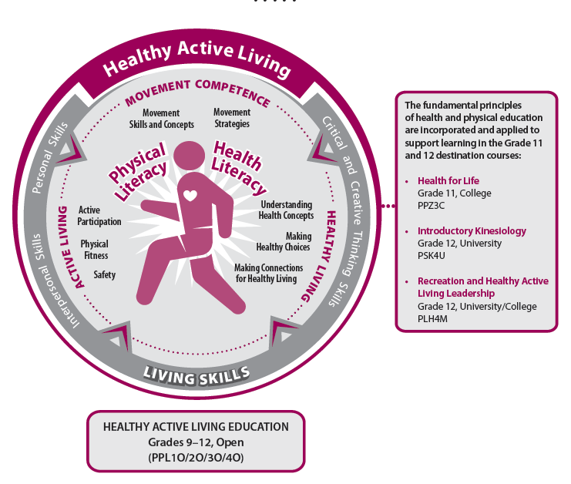
Focus Course Advocacy and Implementation

Slide 2
Workshop Learning Goals
Use criteria to determine if a focus course meets the H&PE Curriculum requirements;
Use tools to effectively design a quality focus course; and
Explore how all curriculum expectations may be met through the particular lens of the focus course.

Slide 3
Let’s Start Where You Are!
Thinking about focus courses in the context of the H&PE Curriculum:
What do you know about the curriculum?
What do you want to know more about?
What might be some of the opportunities and challenges with implementation in your classes/at your school?
What do you want to think more about today?

Slide 4
H&PE and the Renewed Vision for Education
Achieving Excellence
Ensuring Equity
Promoting Well-being
Enhancing Public Confidence

Slide 5
Vision of the H&PE Curriculum
“The revised Health and Physical Education Curriculum is based on the vision that the knowledge and skills students acquire in the program will benefit them throughout their lives and enable them to thrive in an ever-changing world by helping them develop physical and health literacy as well as the comprehension, capacity and commitment they will need to lead healthy, active lives and promote healthy, active living” (Ontario Ministry of Education, 2015a, p. 6).

Slide 6
Developing Physical Literacy
“Individuals who are physically literate move with competence and confidence in a wide variety of physical activities in multiple environments that benefit the healthy development of the whole person.
Physically literate individuals consistently develop the motivation and ability to understand, communicate, apply and analyze different forms of movement.
They are able to demonstrate a variety of movements confidently, competently, creatively and strategically across a wide range of health-related physical activities.
These skills enable individuals to make healthy, active choices that are both beneficial to and respectful of their whole self, others and their environment” (Physical and Health Education Canada, 2016).

Slide 7
Developing Health Literacy
“Health literacy involves the skills needed to get, understand and use information to make good decisions for health. The Canadian Public Health Association’s Expert Panel on Health Literacy defines it as the ability to access, understand, evaluate and communicate information as a way to promote, maintain and improve health in a variety of settings across the life-course” (Rootman, I. & Gordon-El-Bihbety, D., 2008).

Slide 8
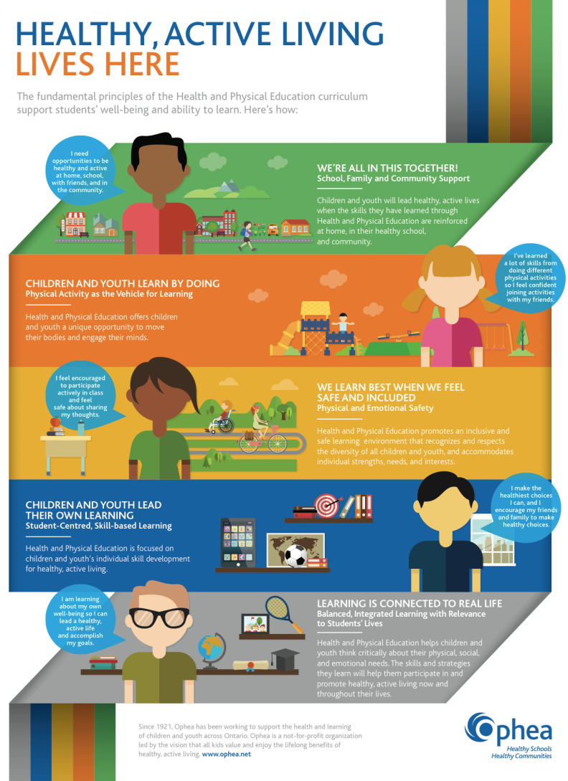
The Fundamental Principles of Health and Physical Education

Slide 9
The Intent of Focus Courses
Meet the interests and needs of students by providing a variety of courses that offer a wide assortment of physical activities
Increase the rate of student participation in physical activity
Engage a wider number of students by responding to their interests
Improve programming flexibility and broaden the range of options available to students
Allow students to customize their individual pathways to better suit their interests and needs (Ontario Ministry of Education, 2015a, p. 21)

Slide 10
The Learning in Focus Courses
The Healthy Active Living Education courses outlined in the curriculum are designed to allow schools to develop courses from Grades 9 to 12 that focus on a particular group of physical activities as the vehicle through which students achieve the curriculum expectations. The activity area chosen as the focus for a course should be seen strictly as the medium through which students will achieve the course expectations, including the Living Skills expectations. Regardless of the particular area on which a course is focused, students must be given the opportunity to achieve all the expectations for the course that are set out in this document (Ontario Ministry of Education, 2015a, p. 20).

Slide 11
The Learning in Focus Courses (Continued)
“The intent behind focus courses is not to focus on a single sport – in other words, not to offer a “hockey course” or a “basketball course” or a “tennis course” – but rather to give students the opportunity to experience a variety of physical activities as they acquire knowledge and skills related to healthy living” (Ontario Ministry of Education, 2015a, p. 21).

Slide 12
Tools to Support the Design of a Focus Course

Slide 13
The Evolution of Focus Courses
Focus Courses for PPL1O, PPL2O, PPL3O and PPL4O:
Healthy Living and Personal and Fitness Activities (PAF);
Healthy Living and Large-Group Activities (PAL);
Healthy Living and Individual and Small-Group Activities (PAI);
Healthy Living and Aquatic Activities (PAQ);
Healthy Living and Rhythm and Movement Activities (PAR); and
Healthy Living and Outdoor Activities (PAD)
A student may take more than one HALE course for credit in each of Grades 9, 10, 11, and 12, provided that the focus of each course is different.

Slide 14
Course Codes
The course description for a focus course should start with the full course description for the HALE course for the particular grade, and end with a statement describing the types of activities that the course will focus on.
For example, the course description for a Grade 11 Individual and Small Group Activities course (PAI3O) would use the description for the Grade 11 Healthy Active Living Education course (PPL3O), followed by a statement describing the focus activities (e.g., “The course will focus on a variety of individual, dual and small group activities, such as golf, combatives, athletics and curling”).

Slide 15
Differentiation and the Focus of Learning
Focus courses:
provide countless, teachable moments to focus the learning on student interests and needs;
provide the opportunity for students to explore concepts from a variety of perspectives connected to the focus of the course;
Require thoughtful planning to differentiate instruction considering different entry points to a topic, the process by which students gather information and how students demonstrate their learning.

Slide 16
Mapping the Curriculum for Focus Course Development
A curriculum map is a planning tool used for examining and organizing curriculum expectations that allows educators to determine how content, skills and assessments will unfold over the course of the semester.
A curriculum map is an in-depth view of concepts teachers will address over the course, their pacing and how they connect with other concepts within the course and in other subjects at the same grade level.
A curriculum map may include:
curriculum connections (concepts, skills and activities); and/or
assessments; and/or
essential questions/big ideas.

Slide 17
Exploring the Mapping Process – Scenario 1
Curriculum mapping occurs horizontally for ALL courses being offered at a grade level.
Create a matrix using only the courses offered.
Use the examples from the curriculum expectations to begin the planning process (if possible).
In cases where the curriculum expectation does not provide an explicit example it will be important to consider the desired outcome for the focus course and what activities have been utilized in the other courses at the same grade level.
Continue the process of looking at each curriculum expectation and identifying the key concepts or content pieces that can be utilized to meet the appropriate focus.

Slide 18
Scenario 1 - You Try It
On chart paper, participants create a chart consisting of 8 columns by 2 rows.
Identify the focus courses being offered at the given school and place them as headings horizontally along the top row, starting in the second column. Place the chosen grade vertically starting in the second row of the first column.
Begin to explore the curriculum expectations at an appropriate grade level where there are examples of activities provided within the specific expectations of the H&PE Curriculum.
This chart begins by examining the specific expectation A2.1 from Grade 11. The examples provided are cycling, sledge hockey, snowshoeing and continuous moving during a game.
Place each identified activity into the chart in the appropriate course or courses where it best fits.
In cases where the activity appears in more than one course the strategy is to provide the focus or context in which that activity will occur.
Grade | HALE | PAF | PAL | PAI | PAQ | PAR | PAD
Grade 11 | Cycling (Fitness Activities: spin cycle – individual) | Cycling (Fitness Activities: spin cycle – group spin class) | Sledge hockey | Cycling (sidewalk, road, bike path) or mountain biking | Endurance swim, water running | N/A | Snow-shoeing

Slide 19
Exploring The Mapping Process – Scenario 2
Curriculum mapping occurs both vertically and horizontally for ALL courses being offered at each grade.
Create a matrix using only the courses offered.
Use the curriculum expectations that share common language and provide an appropriate sequence from Grades 9-12 (note: this is more challenging in the Healthy Living strand and it may be necessary to consider a more thematic approach to the content delivery).
Use the examples from the curriculum expectations to begin the planning process (if possible).
In cases where the curriculum expectation does not provide an explicit example it will be important to consider the desired outcome for the focus course and what activities have been utilized in the past.
Continue the process of looking at each curriculum expectation and identifying the key concepts or content pieces that can be utilized to meet the appropriate focus and ensure differentiation between all courses at all grades.

Slide 20
Scenario 2 - You Try It
Grade 11 (PPL30): A1.1 actively participate in physical activities (e.g., being appropriately prepared and equipped to participate in the activity, being engaged in the activity, striving to do their personal best, adapting to challenges when exploring new activities, monitoring their progress and successes in order to boost their confidence and increase their willingness to try new activities) in a variety of settings, choosing from a wide and varied range of activities (e.g., individual activities, such as t’ai chi and weight-lifting; small- and large-group activities, such as wheelchair basketball, hacky sack; outdoor pursuits, such as cross-country running and softball; recreational and leisure activities, such as golf, tennis, table tennis, bocce and curling) [PS, IS].
Grade 12 (PPL40): A1.1 actively participate in physical activities (e.g., being appropriately prepared and equipped to participate in the activity, being engaged in the activity, striving to do their personal best, adapting to challenges when exploring new activities, monitoring their progress and successes in order to boost their confidence and increase their willingness to try new activities) in a variety of settings, choosing from a wide and varied range of activities (e.g., individual activities, small- and large-group activities, outdoor pursuits, recreational and leisure activities) [PS, IS].

Slide 21
Scenario 2 - You Try It (cont’d)
Grade | HALE | PAF | PAQ
Grade 10 | Not offered | Not offered | Not offered
Grade 11 | Fitness activities, Individual Fitness programs | Training methods – activity specific – endurance, power, strength based programming | Endurance training, endurance swim requirements for Bronze Medallion, Bronze Cross
Grade 12 | Building on prior learning, exploring fitness options beyond High School. | Building on prior learning – through guest speakers, strength coaches, personal trainers, opportunities in the community | Not offered

Slide 22
Additional Resources to Support the Development of Focus Courses

Slide 23
Adopting an Inquiry Stance In Health & Physical Education

Slide 24
Using the Inquiry Process to Support Planning for Healthy Living in Focus Courses
PAI2O
C2.1, C2.2, C3.1: How can you inspire people to choose healthier foods?
C1.1, C2.3, C3.2: How should we respond to harassment in the locker room or on the field?
C2.5, C3.4, C3.5: How could you end a relationship respectfully? How important is it that you have a sexual health plan?
PAF2O
C2.1, C2.2, C3.1: How does what I choose to eat impact my fitness?
C1.1 ,C2.3, C3.2: What role do conflict resolution skills play in reducing vulnerability to harassment while at the gym or fitness club?
C2.5, C3.4, C3.5: How can we create a comfortable environment where everyone feels a part of the group regardless of sexual orientation or gender identity? How do I know if I’m ready to be intimate with my partner?

Slide 25
Using the Inquiry Process to Support Planning for Healthy Living in Focus Courses
PAD3O
C1.1, C3.1: How might different diseases and health conditions impact meal planning for winter camping?
C1.2, C1.3, C2.1, C3.2: Why would the consequences of risk taking change when outdoors? How can a trip with so many safety checks fail?
C2.2, C3.3: Why do people choose to use drugs when they know the negative effects?
PAD4O
C2.1, C3.1: What should you consider when buying food for a prolonged camping trip in the different seasons?
C1.1, C2.2, C3.2: How would you deal with the disruption of accessing your regular support network while away on trip?
C1.2, C2.3, C3.3: Does the use of extreme outdoor activities in alcohol ads have an impact on substance use?
See: Section 7: Planning for Teaching Healthy Living in a Focus Course Using the Inquiry Process for additional sample questions.

Slide 26
Exploring Approaches to Teaching Healthy Living

Slide 27
What’s Next?

